Slide 1

Mira Lane
Selected studies / 2026
A few things
I’ve made.
Print, objects and the details in between.
A portfolio of self-initiated studies
Fictional creator. Original concept studies, not client work.
01 / 10
Notes:
Fictional creator. Original concept studies, not client work.

Slide 2
Mira Lane
Selected studies / 2026
Small projects,
close attention.
An independent practice working across print, object studies and visual storytelling. I’m interested in familiar materials and the details that make them feel new.
A quiet composition. A useful edit. Enough room for the work.
Mira Lane is a fictional practice created for this concept portfolio.
Fictional creator. Original concept studies, not client work.
02 / 10
Notes:
Fictional creator. Original concept studies, not client work. Mira Lane is a fictional practice created for this concept portfolio.

Slide 3
Mira Lane
Selected studies / 2026
Three studies
01
Margin Journal
Editorial direction
02
Quiet Objects
Still-life direction
03
After the Rain
Visual storytelling
Three directions, connected by a close look at everyday materials.
Fictional creator. Original concept studies, not client work.
03 / 10
Notes:
Fictional creator. Original concept studies, not client work. Three directions, connected by a close look at everyday materials.

Slide 4
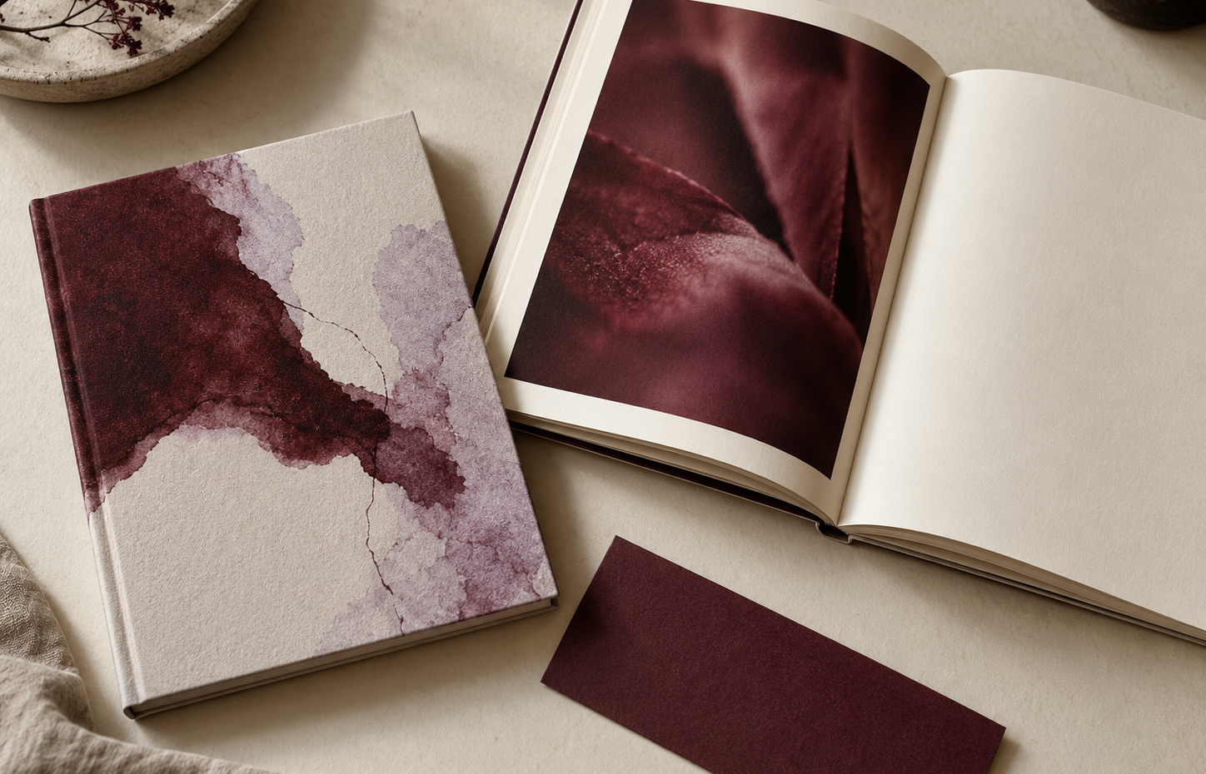
Mira Lane
Selected studies / 2026
Editorial direction
Margin Journal
An independent journal about the texture of ordinary things.
Use a quiet grid, generous margins and one deep color to hold the issue together.
A study in pacing, paper and the space around an image.
Self-initiated concept. Original AI-generated print study.
Fictional creator. Original concept studies, not client work.
04 / 10
Notes:
Fictional creator. Original concept studies, not client work. Self-initiated concept. Original AI-generated print study.

Slide 5
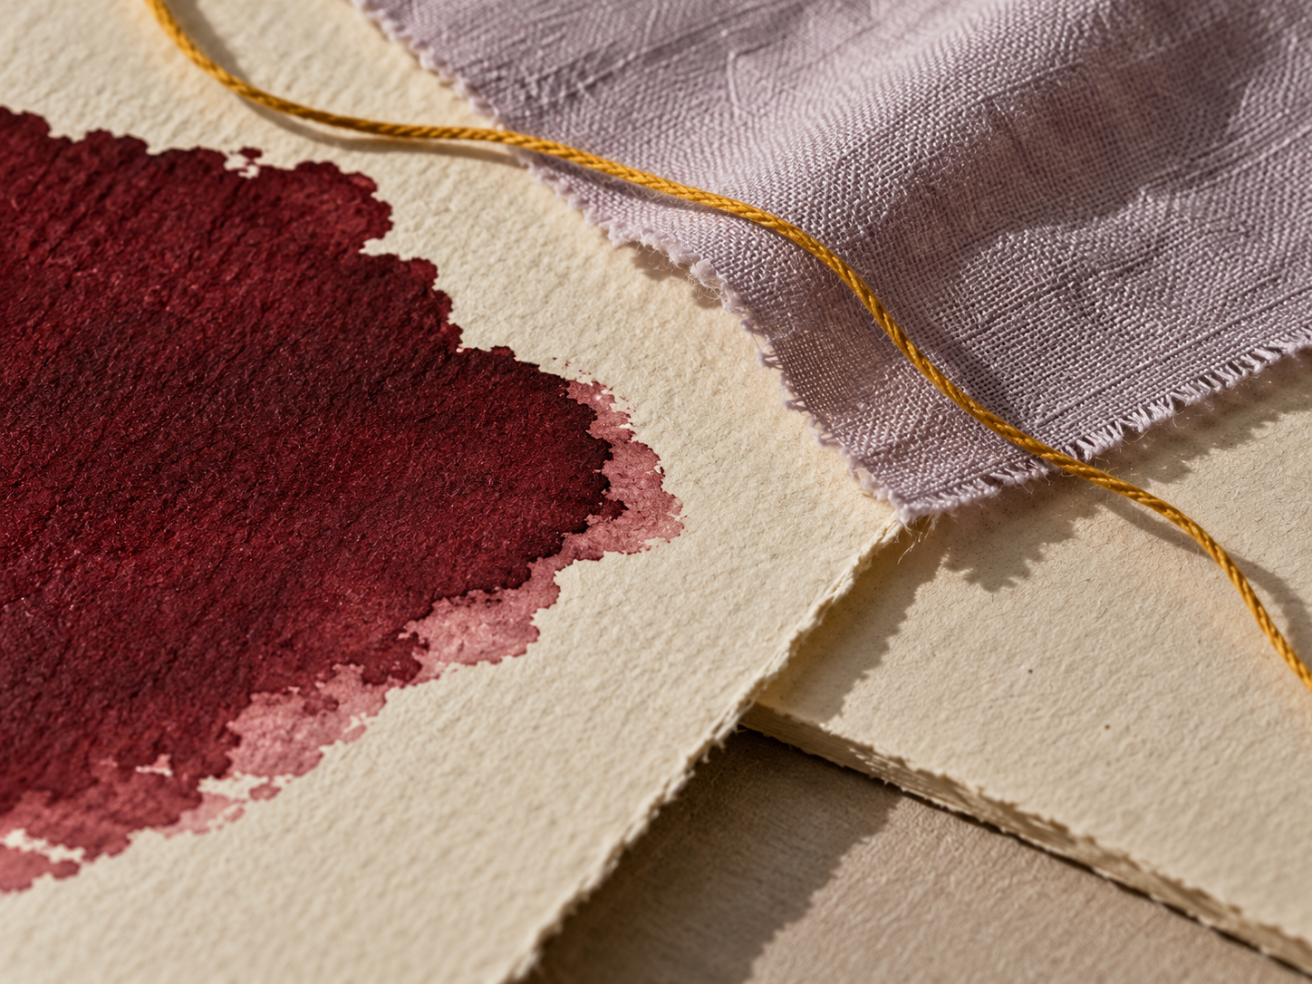
Mira Lane
Selected studies / 2026
The details
set the tone.
Paper, color and surface are part of the same decision. The material study gives the publication a small, consistent vocabulary.
Original AI material study for the concept direction.
Fictional creator. Original concept studies, not client work.
05 / 10
Notes:
Fictional creator. Original concept studies, not client work. Original AI material study for the concept direction.

Slide 6
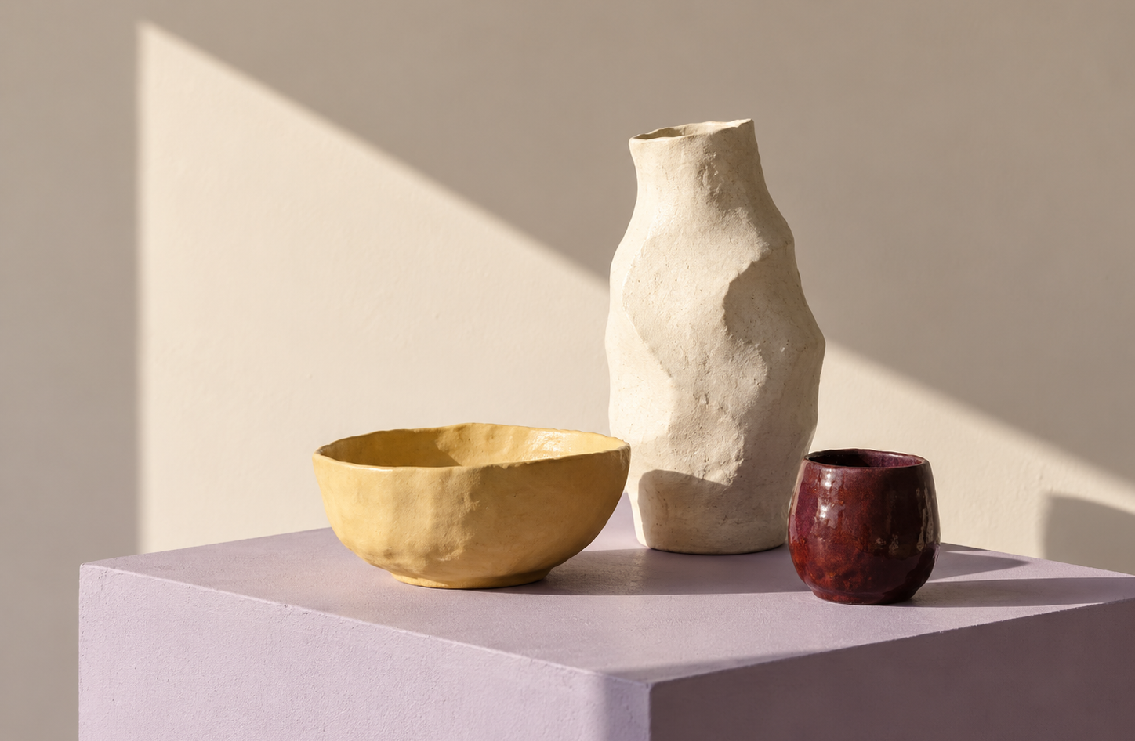
Mira Lane
Selected studies / 2026
Still-life direction
Quiet Objects
An object study built around shape, material and afternoon light.
Keep the palette restrained and let the shadows do part of the composition.
Original AI concept study, not a commissioned product collection.
A few objects, considered together.
Fictional creator. Original concept studies, not client work.
06 / 10
Notes:
Fictional creator. Original concept studies, not client work. Original AI concept study, not a commissioned product collection.

Slide 7
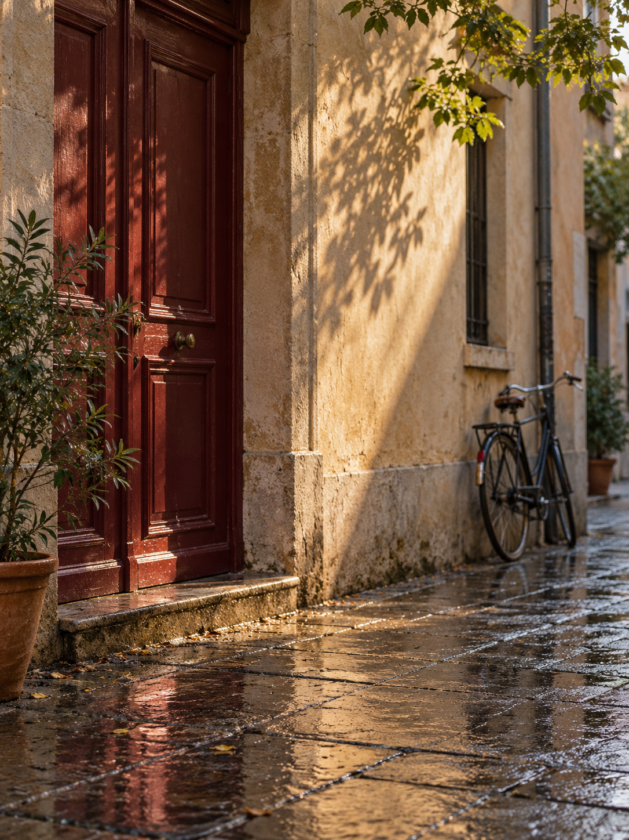
Mira Lane
Selected studies / 2026
Visual storytelling
After the Rain
An imagined walk through a quiet side street after the rain.
Look for reflections, worn surfaces and the pause between everyday details.
A short visual story about noticing what is already there.
AI-generated scene, not a photograph of a documented place.
Fictional creator. Original concept studies, not client work.
07 / 10
Notes:
Fictional creator. Original concept studies, not client work. AI-generated scene, not a photograph of a documented place.

Slide 8
Mira Lane
Selected studies / 2026
How a project
takes shape
01
02
03
Observe
Edit
Refine
Start with a question and collect a few useful references.
Choose the details that support the story.
Test the composition, remove distractions and check the final form.
A proposed working method for these self-initiated studies.
Fictional creator. Original concept studies, not client work.
08 / 10
Notes:
Fictional creator. Original concept studies, not client work. A proposed working method for these self-initiated studies.

Slide 9
Mira Lane
Selected studies / 2026
Project notes
Study | Focus | Year
Margin Journal | Editorial direction | 2026
Quiet Objects | Still-life direction | 2026
After the Rain | Visual storytelling | 2026
All three are self-initiated concepts. No client commission is represented.
Fictional creator. Original concept studies, not client work.
09 / 10
Notes:
Fictional creator. Original concept studies, not client work. All three are self-initiated concepts. No client commission is represented.

Slide 10
Mira Lane
Selected studies / 2026
More to make.
More to notice.
Open to thoughtful conversations about print, images and small creative projects.
Start with a conversation
Replace this invitation with your actual next step and contact.
Fictional creator. Original concept studies, not client work.
10 / 10
Notes:
Fictional creator. Original concept studies, not client work. Replace this invitation with your actual next step and contact.

